Slide 1
Recursion
Neeraj Jain and Rahul Gupta

Slide 2
Objective
What is Recursion ?
How it works ?
Different types of Recursion
Recursive Algorithms

Slide 3
What is Recursion
Recursion is a method of solving problems that involves breaking a problem down into smaller and smaller subproblems until you get to a small enough problem that it can be solved trivially.
Subprograms are an indispensable part in writing programs to solve problems.
In some cases, the smaller problem is fundamentally the same as the original problem.

Slide 4
Benefits
Reusing the same technique (with different size inputs) and so fewer subprocedures need be written.
Recursion is a powerful and elegant way of solving problems.
Sometimes a recursive solution is easier to create than an iterative one even if one does not see it a first.

Slide 5

Factorial Example
The factorial for any positive integer n, written n!, is defined to be the product of all integers between 1 and n inclusive

Slide 6
Factorial example without recursion
public static int factorial(int n) {
int product = 1;
for (int i = 1; i <= n; i++)
product *= i;
return product;
}

Slide 7

Recursive Factorial
Factorial can also be defined recursively:
A factorial is defined in terms of another factorial until the basic case of 0! is reached

Slide 8
Recursive Factorial Contd...
public static int factorial(int n) {
if (n == 0)
return 1;
else
return n * factorial(n - 1);
}

Slide 9
How Recursion Works ?
Each call sets up a new instance of all the parameters and the local variables
As always, when the method completes, control returns to the method that invoked it (which might be another invocation of the same method)
factorial(4) = 4 * fact(3)
= 4 * 3 * fact(2)
= 4 * 3 * 2 * fact(1)
= 4 * 3 * 2 * 1 * fact(0)
= 4 * 3 * 2 * 1 * 1
= 24

Slide 10
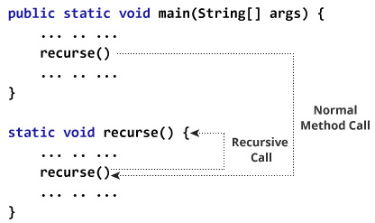
How Recursion Works ?

Slide 11
Recursion and Iteration
Anything one can do with iteration, one can do with recursion.
Anything one can do with recursion, one can do with iteration.
“Anything that, in happening, causes itself to happen again, happens again.”

Slide 12
Anatomy of Recursion
Base Case : A simple case solved immediately without requiring recursion.
General case : A case for many inputs solved with recursion.
Smaller-caller issue : Each recursive call must involve a “smaller” problem or one “closer” to the base case.

Slide 13
Weiss’s Rules for Recursion
Always have at least one case that can be solved WITHOUT recursion.
Any recursive call must make progress towards a base case.
Assume the recursive call works.
Never duplicate work by solving the same instance of a problem in separate recursive calls

Slide 14
Infinite Recursion
A definition with a missing or badly written base case causes infinite recursion, similar to an infinite loop.
public static int factorial(int n) {
return n * factorial(n - 1); // Forgot base case
}

Slide 15
Infinite Recursion Contd...
factorial(4) = 4 * fact(3)
= 4 * 3 * fact(2)
= 4 * 3 * 2 * fact(1)
= 4 * 3 * 2 * 1 * fact(0)
= 4 * 3 * 2 * 1 * 0 * fact(-1)
= 4 * 3 * 2 * 1 * 0 * -1 * fact(-2)
= ... crashes: Stack Overflow Error!

Slide 16
Types of Recursion
Single and Multiple Recursion
Direct and Indirect Recursion

Slide 17
Single and Multiple Recursion
Recursion that only contains a single self reference is known as single recursion. Eg. Factorial function.
return n * fact(n-1)
Recursion that contains a multiple self reference is known as multiple recursion. Eg. Fibonacci function.
fib(n) = fib(n-1) + fib(n-2)

Slide 18
Direct and Indirect Recursion
If a function F calls itself (i.e.) F calls F. Then this recursion is Direct Recursion.
static int direct(int n) {
if(n <=0) return 0;
else return n + direct(n-1);
}

Slide 19
Direct and Indirect Recursion
If a function F calls G and and function G calls F. Then this recursion is Indirect Recursion.
static int inDirect(int n) {
if(n <=0) return 0;
else return n + buddy(n-1);
}
int buddy(int n) {
return inDirect(n);
}

Slide 20
Recursive Fibonacci Algorithm
procedure fib(n: non negative integer)
If n=0 then fib(n) := 0
else if n=1 then fib(1) := 1
else fib(n) := fib(n-1) + fib(n-2)

Slide 21
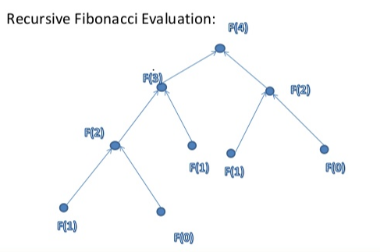

Slide 22
Tower of Hanoi
Initially, the disks are placed in decreasing size on start stack.
The objective is to move them to end stack, making also use of an auxiliary stack.

Slide 23
Tower of Hanoi
Conditions for moving the disks are:
All disks (except the one to be moved) have to be on one of the three stacks.
It is possible to move only one disk at a time, taking it from the top of the tower on one of the stack and placing it on the top of the tower on another stack.
A disk can never be placed on a smaller disk.

Slide 24
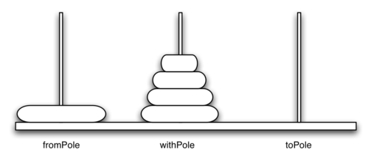
Tower of Hanoi
Example with 5 Disks

Slide 25
Tower of Hanoi
Base Case - When n = 1
Move the disc from start stack to end stack
Recursive Case - When n > 1
Step 1: Move (n-1) discs from start stack to auxiliary stack .
Step 2: Move the last disc from start stack to end stack .
Step 3: Move the (n-1) discs from auxiliary stack to end stack .
Steps 1 and 3 are recursive invocations of the same procedure.

Slide 26
Summary
Recursion is a good problem solving approach when the problem is difficult to solve using iterations, and recursive algorithms are easy to understand and implement.

Slide 27
Assignment

